Slide 1
Google Analytics Ecommerce Prediction model
By Rahul Singh

Slide 2
Problem/project goal
Common ecommerce problem is to keep traffic incoming on there platform. Customer rendition rate on ecommerce platform needs to be analyzed and enhance.
Goal: Create a model that can capture churn rate of customer shopping on googles ecommerce platform.

Slide 3
Data wrangling
Data source: Google analytics https://console.cloud.google.com/bigquery?project=capstone-334200&ws=!1m5!1m4!4m3!1sbigquery-public-data!2sgoogle_analytics_sample!3sga_sessions_20170801
Data is parsed into the notebook in JSON format and cleaned using Pyspark API.
This involved complex cleaning and restructuring data. Field required expression replacement to reduce data frame size. Non useful field have been dropped under alias drop list.

Slide 4
eda
What's the most common medium used to direct traffic on to the platform?
What’s the most common device used?
What’s the most common source of each traffic?

Slide 5
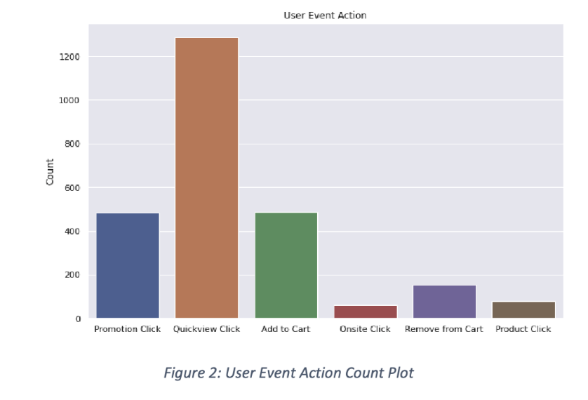
Insights: User event action
Most users are viewing the product with quick view click[~70%] followed by an equal share of items being added to cart and promotion click.

Slide 6
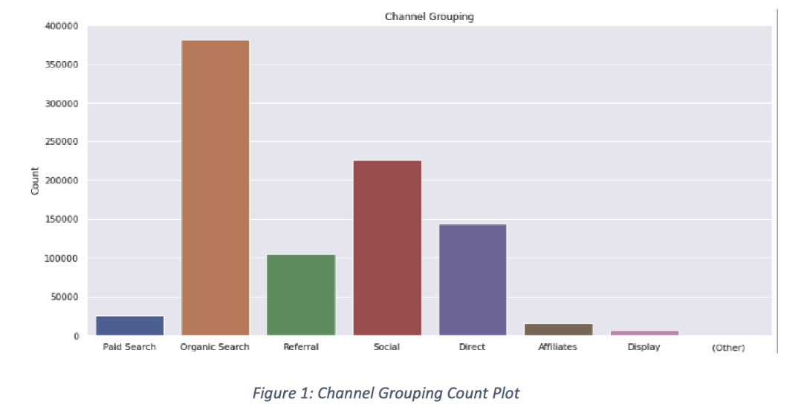
Insight: Channel grouping
Most traffic on the platform is coming from an organic search with social and direct being 2nd and 3rd. This indicates most users are searching the platform via google search engine.

Slide 7
Feature engineering
Goal is to reduce data size and create features that show user behavior in quantified vector for ML model.
Window functions are created for 30-day period to look back and forward for training the model. This field is to state whether customer churned[1(churn) /0 (active user)] with last 30 days.
Key features created from user behavior: avgsession, browstime, serverdelay time, avgdomain time, avg amount spent and churn.
Churn_vf30d field calculation : 30-day window based on max vistinumber, datetime and userID.

Slide 8
modeling
Goals: create a ML model and see accuracy results to churn rate.
GridSearchCV for hyper tuning the model with parameters to get adequate results.
Model training/testing with 70/30 split.

Slide 9
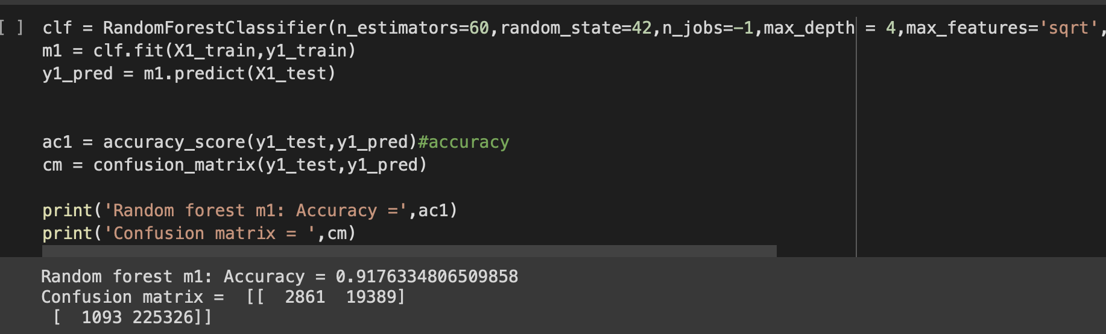
Random forest model
Random forest model had accuracy of 91.76%. Model is overfitting the data , hyper tunning is needed to create a more realistic output.

Slide 10
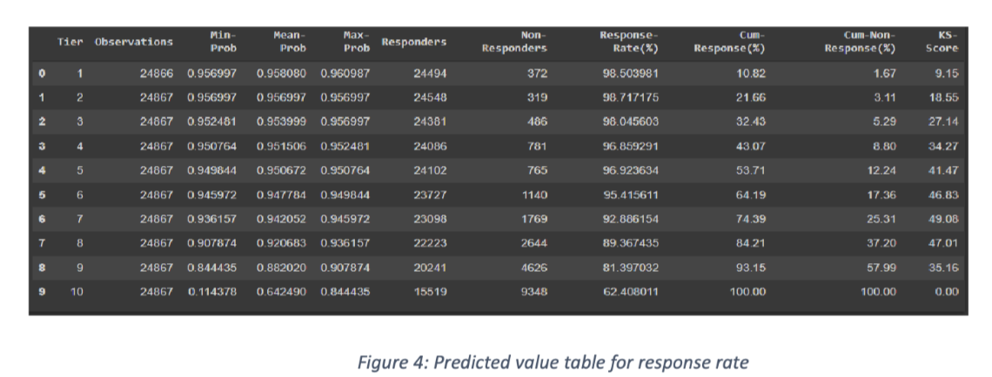
Hyper tuning model
During predict function model was quantifying 1[churn] if result was > 0.50 or 0[active user] if lower. Probability function was off giving a very low response rate. We create a new func to hyper tuned parameters and check to see probability threshold. At 0.54 we get a accurate representation of data.

Slide 11
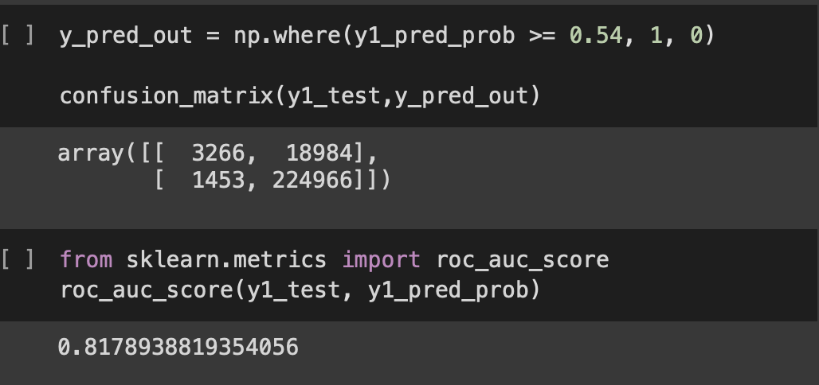
Model results
Increasing probability function to >= 0.54 we get a higher response rate and model roc accuracy of 81.79%

Slide 12
Conclusion/improvements
Random forest model had accuracy of 81.79%.
For future improvements we can test with a logistic regression or SVM to compare for the best model in production.
Model has room for improvement with data enrichment and different type of ML model to be used.
This model can help companies with increasing customer retention program or marketing strategies to direct traffic towards there platform.

